Slide 1
DISCUSSION 2025 MAY

Slide 2
Revision history
Updated date | Note
2025.05.16 | Visualization of codebooks
2025.05.16 | Analysis of codebooks
2025.05.19 | Analysis of annotations
2025.05.20 | Data pipeline

Slide 3
Summary of last week
Codebook visualization
Codebook analysis

Slide 4
Codebook Visualizations
Visualization for overall structure and subtrees
Interactive visualization for assigned code
Both are Directed Acyclic Graph (DAG)

Slide 5
Codebook Analysis
Aspect | EPPC Codebook | PV Codebook
Focus | Patient-Provider Communication | Patient Voice (SDoH Themes)
Structure | Dialogue acts: paired Patient/Provider | Thematic SDoH codes with sub-categories
Label Type | Functional intent of utterances | Semantic content of messages
Granularity | Often sentence-level with social function | Message- or sub-message-level with topics
Examples Provided | Yes (for both speaker roles) | Yes (under each sub-theme)
Overlap Potential | Some codes touch on SDoH topics | Some overlap with EPPC (e.g., information giving)
Use Case Suitability | Dialogue modeling, sentiment, behavior | Topic mining, multi-label classification

Slide 6
Working on
Data analysis
Stats
Data processing pipeline for prototype (first draft)

Slide 7
Data analysis
Message
Sentence 1
Sentence 2
……
Sentence N
Sub-Sentence 1
Sub-Sentence 2
……
Sub-Sentence M
Phrase 1
……
Phrase K

Slide 8
Stats
# of annotations in total
# of sentences w/annotations / # of sentences
# of sub-sentences w/annotations / # of sub-sentences (clause level)
Explicit info / implicit info (objective / subjective)
# sub-sentences with factual info
# sub-sentences with opinion
Context dependency (not sure about this)
# sub-sentences require context for interpretation
# sub-sentences are context independent

Slide 9
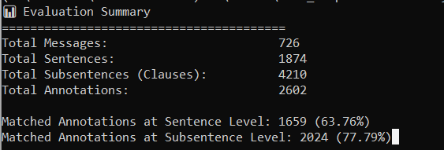
Stats

Slide 10
Sentence Slicing
Steps

Slide 11
Sub-sentence Slicing (clause-level)
Steps

Slide 12

Data preprocessing for analysis
Data Preprocessing
Label Inconsistency
Label Mapping
Similarity & Classification
Codebook
Annotations (Ground Truth)
Raw Data
Graph Construction
Structure Analysis
Tokenized:
Sentence,
Sub-sentence (clause level)
Content & Quality Check
Structure Visualization
Stats & Visualization
Structure Alignment
Structure
Distribution
Quality & Semantic validity

Slide 13
THANK YOU
Yi-Chun (Rimi) Chen
984-500-8488
ychen74@alumni.ncsu.edu
yi-chun.chen@yale.edu

